Slide 1
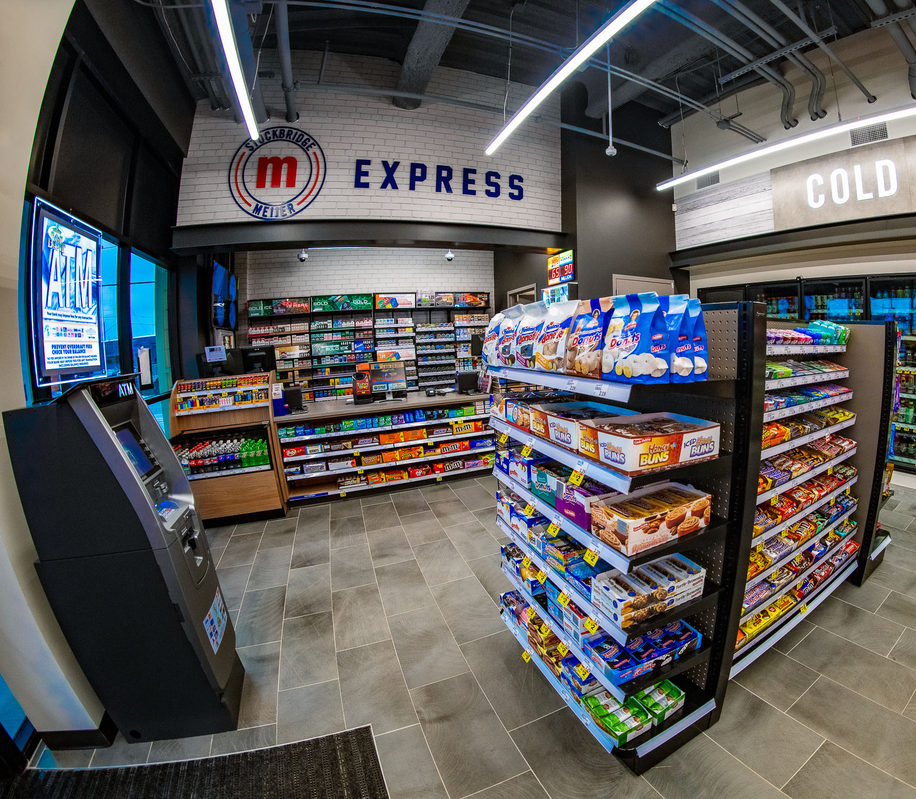


Retail Real Estate Analytics:
Determining
M-Express Locations
Industry Practicum
MS BAIM

Slide 2





TEAM
2
Veda Samhitha Alluri
Email:
alluriv@purdue.edu
LinkedIn: www.linkedin.com/in/veda-samhitha-alluri
Shubhankar Bhajekar
Email: sbhajeka@purdue.edu
LinkedIn: www.linkedin.com/in/shubhankar-bhajekar
Harshraj Jadeja
Email: hjadeja@purdue.edu
LinkedIn: https://www.linkedin.com/in/Harshraj-jadeja/
Husam Saleh
Email: hasaleh@purdue.edu
LinkedIn: www.linkedin.com/in/husam-saleh-421hs
Srinija Srimamilla
Email: ssrimami@purdue.edu
LinkedIn: www.linkedin.com/in/srinija-s

Slide 3




3
01
Project Scope
To develop a scoring algorithm to identify optimal locations for Meijer’s retail footprint expansion
02
Methodology
Encompasses data collection, preprocessing and EDA, culminating in the development of a predictive scoring model for strategic site selection
AGENDA
03
Data
Crafted by web-scraping with API’s, focusing on geospatial and customer-centric attributes for Meijer and its competitors
04
Exploratory Data Analysis
Conducted to identify trends, patterns, and correlations in data for feature selection and optimization

Slide 4




4
05
Data Preprocessing
Involves cleansing, structuring and refining the dataset to enhance the quality and reliability of the data
06
Model Building
Entails constructing a robust, data-driven predictive model on key location-based factors
AGENDA
07
Deployment & Life Cycle
Implemented and managed the model through a dashboard, ensuring ongoing accuracy and adaptability to market changes
08
Limitations & Future Scope
Address current limitations and expand the model's capabilities for broader, future applications

Slide 5




01
5
Project Scope
Defining project outline
Business Problem
To identify optimal locations for new mExpress stores across Michigan that maximize high foot traffic and revenue, with a vision for nationwide scalability.
Project Outcome
Help Meijer prioritize locations by their score, ensuring resources are allocated to the most promising sites.
Analytics Problem
To transform raw location-based data into actionable insights by analyzing Meijer and its competitor’s Store level data (Geospatial + Customer Centric).
Key Deliverables
A scoring model that evaluates the potential success of any given location in terms of customer visits pursuing it as a location for Meijer’s next mExpress.

Slide 6




02
6
Methodology
Analytical process framework
Meijer and Competitor Stores
Meijer Supercenters, M-Express store, and Competitor Stores
Select Store Attributes
Categorize attributes, such as Traffic, Nearby places, and County Demographics
Identify Locations
Identify existing and potential store locations for which data needs to be sourced
Data Frame Creation
Create separate data frames for Meijer and its Competitors as well as a master data frame
Web Scraping
Collect data using Python Libraries and APIs, such as Google Maps and Overpass API

Slide 7


7
Exploratory Data Analysis
Identify trends, patterns and correlations between attributes
Data Preprocessing
Removal of irrelevant features, outliers, and multicollinearity check
Predictive Modeling
Feature Engineering and Selection based on Collinearity
Interactive Dashboard
Deploy model through a PowerBI dashboard with real time updates
Scoring Model
Build a robust scoring model which predicts consumer visits for a location

Slide 8






03
8
Data
Collection of geospatial and
customer-centric attributes
Geo Spatial Data
Customer Data
Traffic Volume
Distance to Highway
County Demographics
AADT
Overpass API, GoogleMapsAPI
Geocodio
Duration to Highway
Nearby Places
Customer Sentiment
Overpass API, GoogleMapsAPI
OpenStreetMap, Overpass API
Yelp, Google

Slide 9
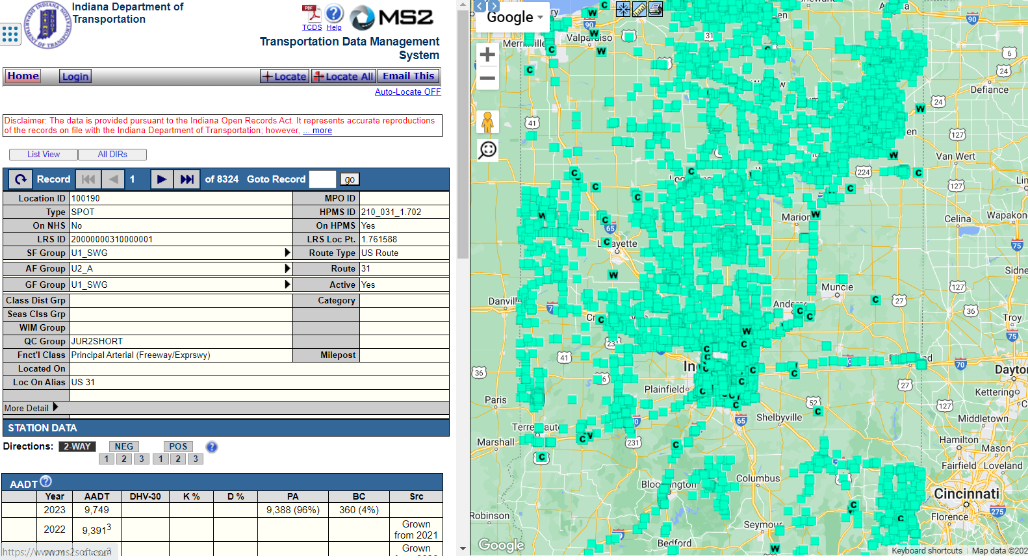
9
Traffic Volume
AADT
Identify States
Data from Department
of Transportation
Identify Store
Latitude & Longitude
Annual Average
Daily Traffic

Slide 10
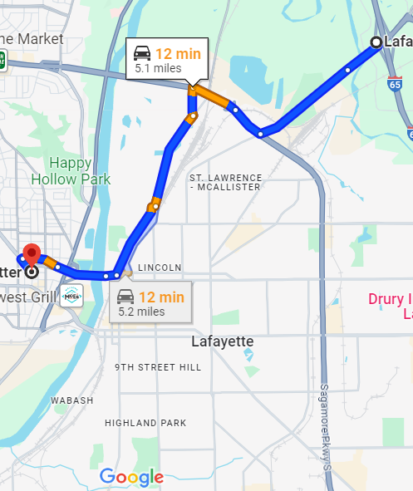



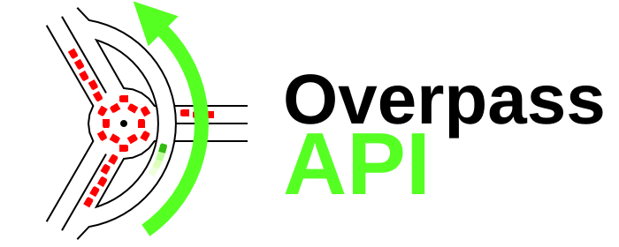
10
Distance to Highway
Duration to Highway
Overpass API, GoogleMapsAPI
Overpass API, GoogleMapsAPI
Coordinates of the
Potential Store Location
Coordinates of the nearest
entry/exit ramp of a highway
Driving Distance between
Highway Exit & Store
Duration from Highway
Exit to reach the Store

Slide 11









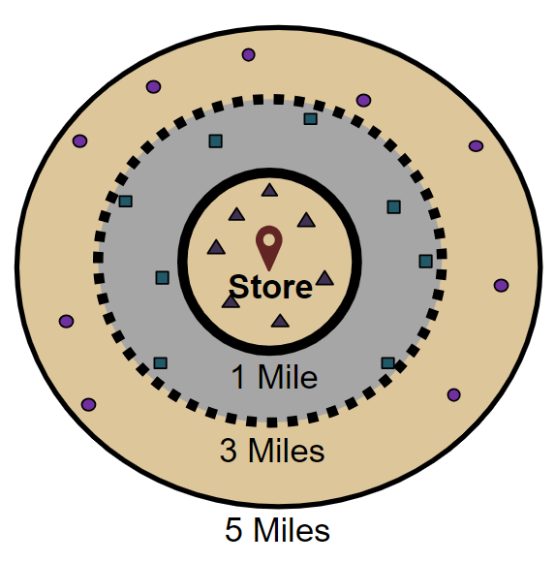
11
Nearby Places
County Demographics
OpenStreetMap, Overpass API
Geocodio
Grocery Stores
Fuel Stations
Residential
Commercial
Educational
Population
No. of Households
Income
Household Value
Age
Gender
1
Hospitals
Apparel Stores
Hotels
Tourist
Airports
3
5

Slide 12
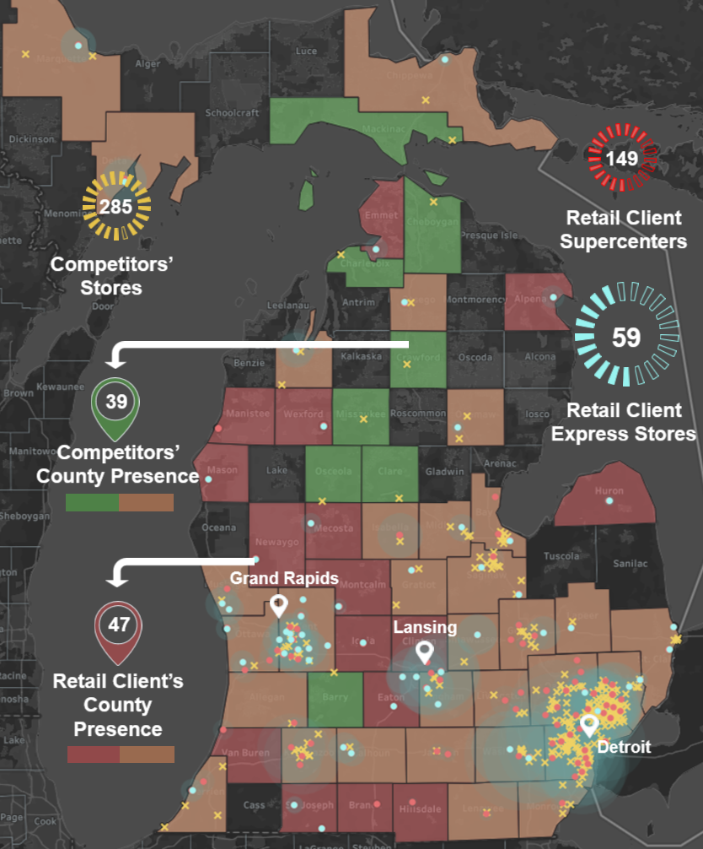






Convenience store landscape
Michigan
Meijer Stores
Identifying Meijer’s presence in each of the counties in Michigan. Visualizing the extent and density of Meijer Supercenters as well as Express Stores.
Competitor Stores
Identifying Competitors’ presence in each of the counties in Michigan. Visualizing the extent and density of their Stores.

Slide 13
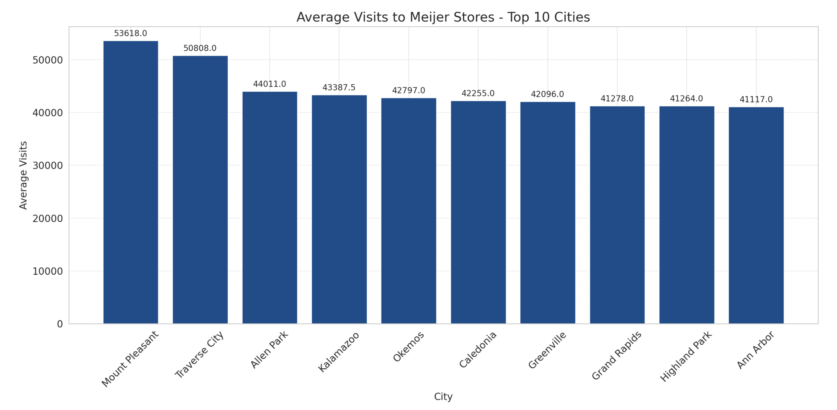
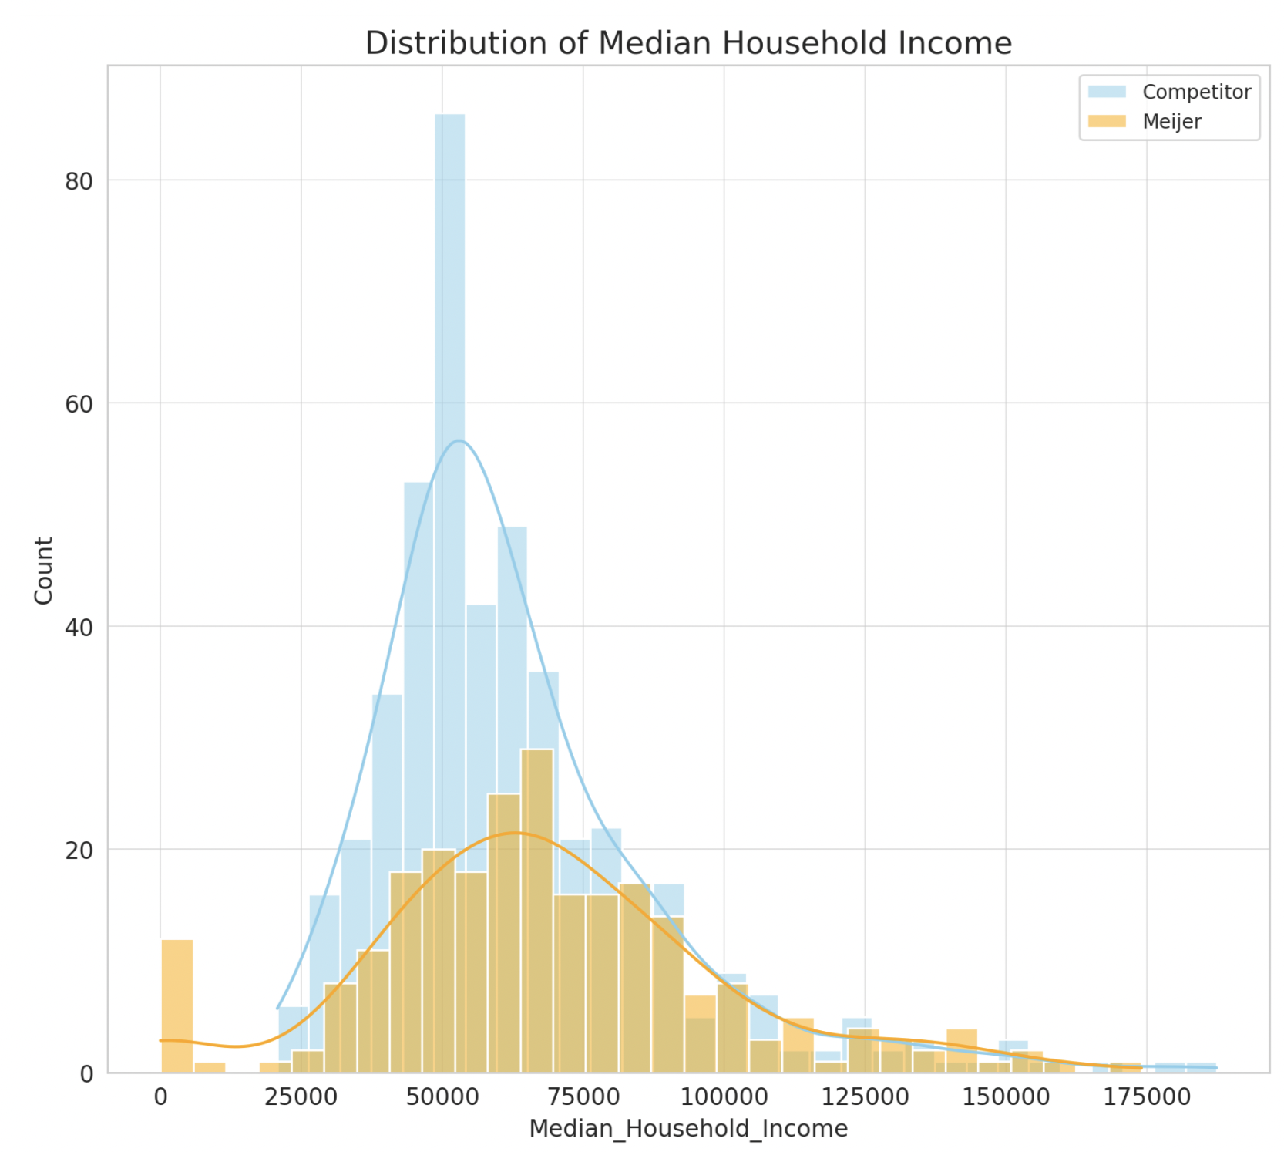
04
13
Exploratory Data Analysis
To identify trends, patterns, and correlations in data for feature selection and optimization
Mount pleasant has the highest average daily store visits followed by Traverse City
Both Meijer and its Competitors target the mid income level consumers. Although Meijer’s target consumers come from a marginally higher household income bucket

Slide 14
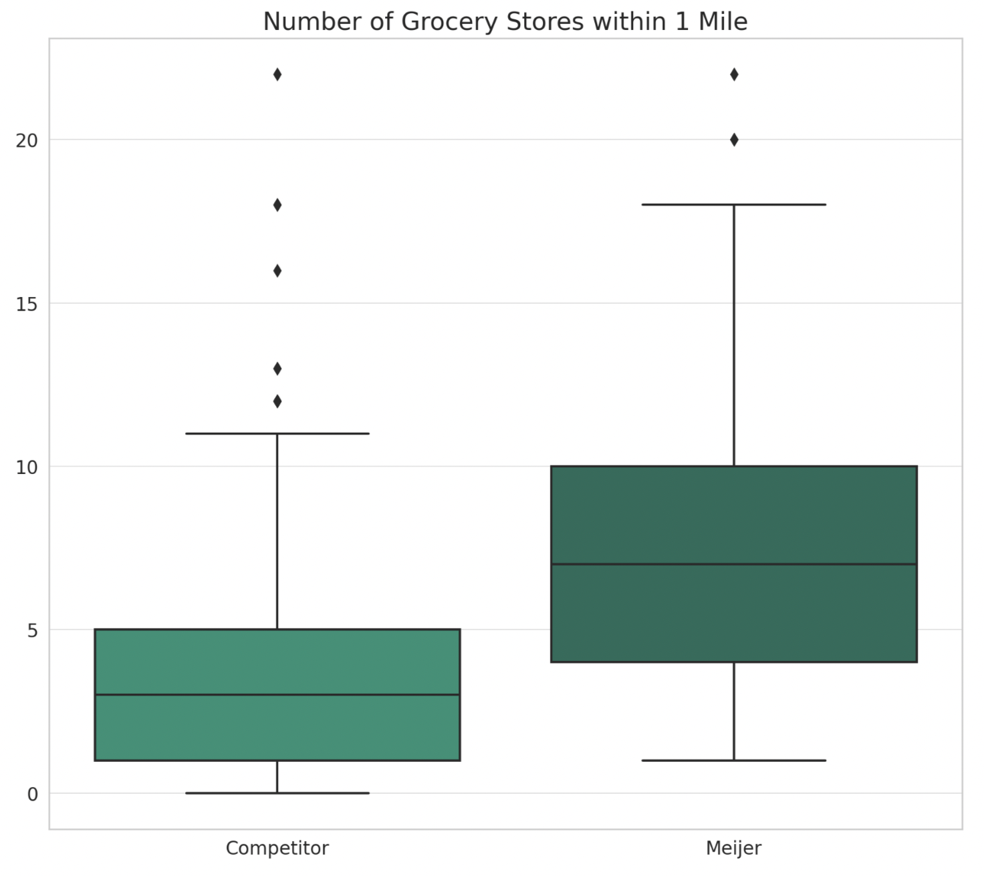
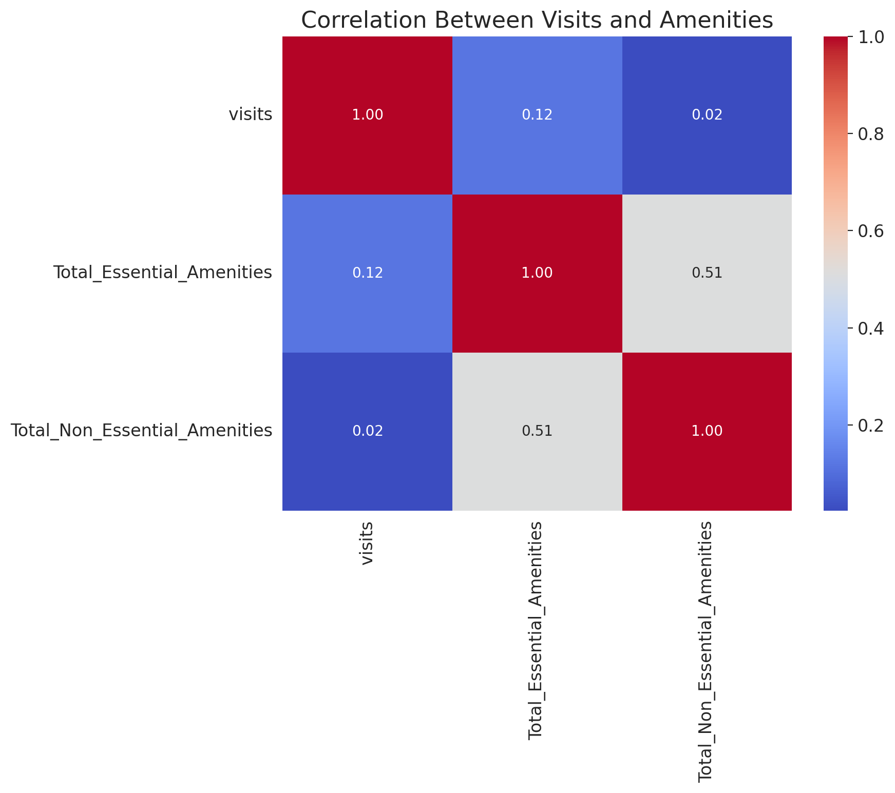
04
14
Exploratory Data Analysis
To identify trends, patterns, and correlations in data for feature selection and optimization
Meijer locations tend to have a slightly wider distribution, suggesting some locations are in more competitive areas than its competitors. (Reason for the higher visits – Anchoring effect)
Presence of Essential amenities (Education, Hospitals & Fuel) is more likely to garner visits than non-essential visits

Slide 15

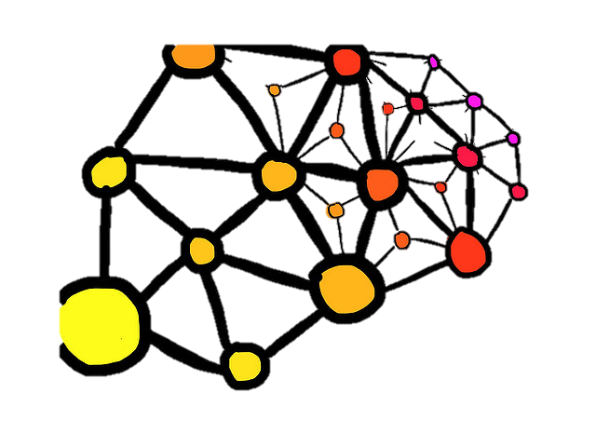


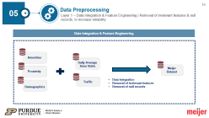

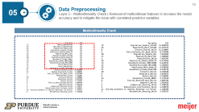
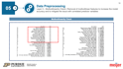
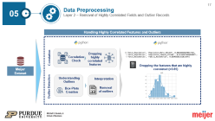

05
15
Data Preprocessing
Enhances the quality and reliability of the data, paving the way for more accurate and meaningful insights
Why?
Data Preprocessing Framework
Removing irrelevant and highly correlated columns improves the overall quality and reliability of the dataset
Enhance Data
Quality
By eliminating multicollinearity and correlated features, we lead to more generalized and robust models
Reduce Overfitting
Risk
Layered Approach
Removing nulls from columns helps in maintaining the integrity of the dataset, ensuring that the analysis is not skewed
Ensure Data
Integrity
Removing outliers can enhance model accuracy by reducing noise and ensuring the training process focuses on the more representative patterns of the data
Removal of
Outliers

Slide 16

05
16
Data Preprocessing
Layer 1 – Data Integration & Feature Engineering | Removal of irrelevant features & null records, to increase reliability
Data Integration & Feature Engineering
Amenities
Daily Average Store Visits
Meijer Dataset
Proximity
Traffic
Data Integration
Removal of irrelevant features
Removal of null records
Demographics
Notes:
HJ

Slide 17



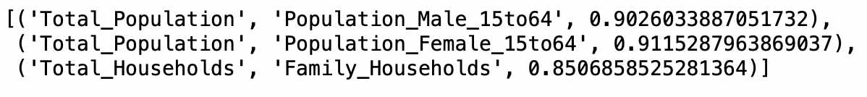

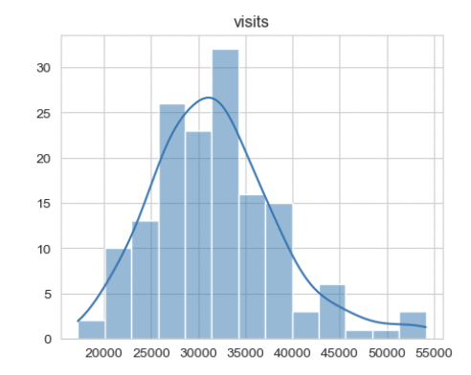


05
17
Data Preprocessing
Layer 2 – Removal of Highly Correlated Fields and Outlier Records
Handling Highly Correlated Features and Outliers
Correlation
Dropping highly correlated features
Correlation Check
Dropping the features that are highly correlated (>0.85)
Meijer Dataset
Outlier Detection
Understanding
Outliers
Interpretation
Box-Plots Creation
Removal of outliers
Notes:
HJ

Slide 18
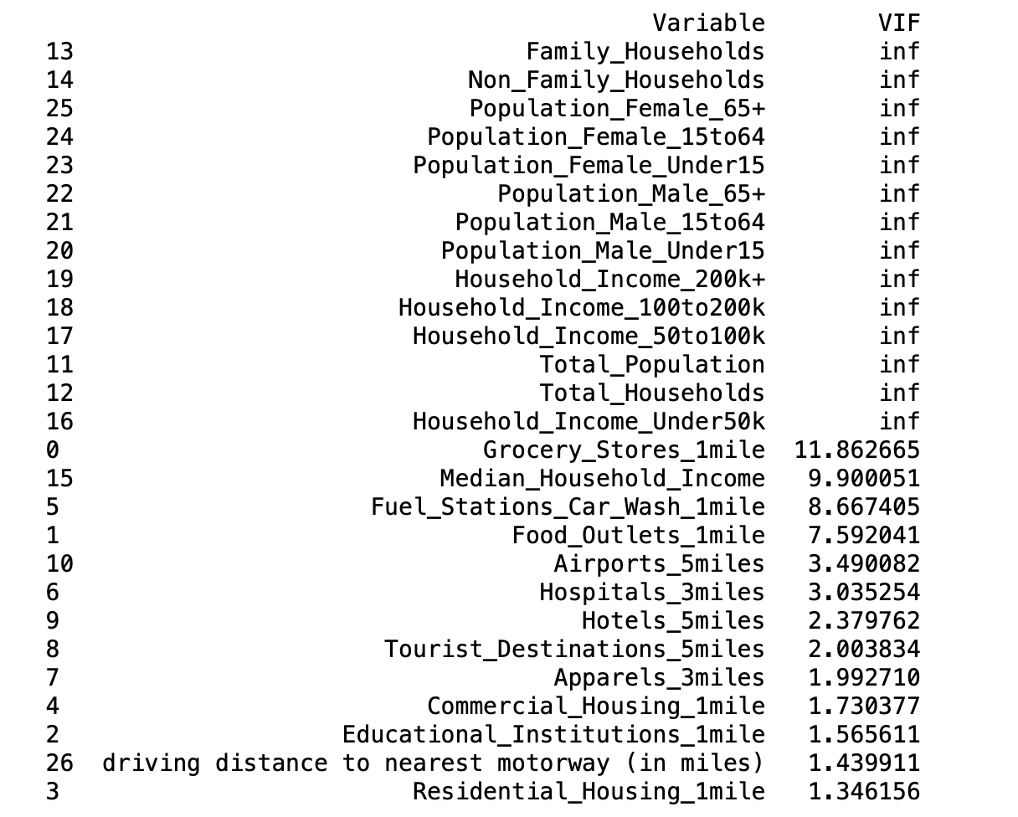
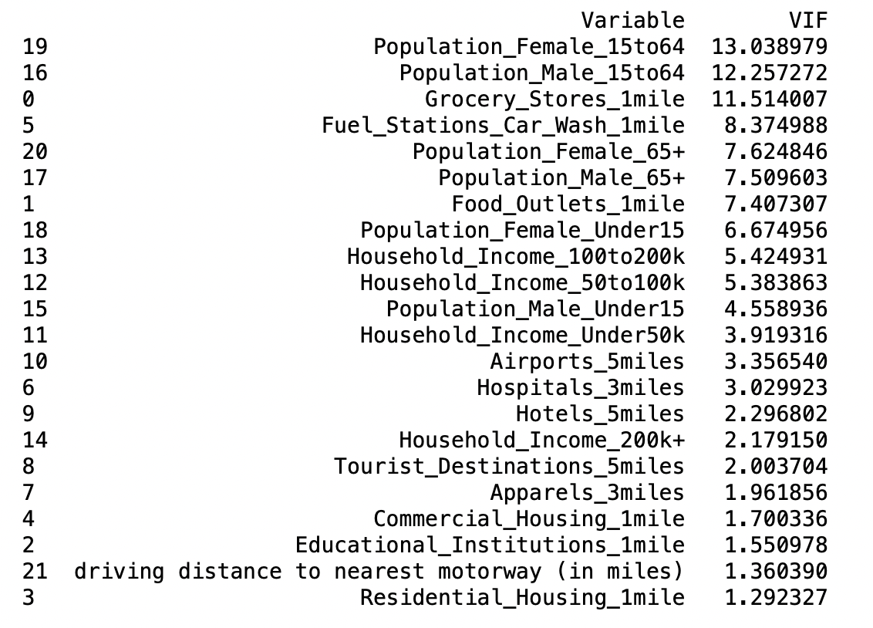
05
18
Data Preprocessing
Layer 3 – Multicollinearity Check | Removal of multicollinear features to increase the model accuracy and to mitigate the issue with correlated predictor variables
Multicollinearity Check
Notes:
HJ

Slide 19
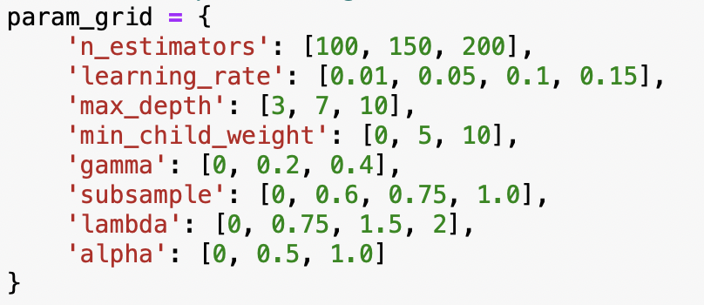
06
19
Model Building
Stage 1 | Predictive Model Building
Data Preparation
Hyperparameter Tuning using GridSearchCV
One-Hot Encoding
Train – Test Split
Scaling
Recursive Feature Elimination
Notes:
HJ

Slide 20

06
20
Model Building
Stage 1 | Performance Metrics
Results for Meijer Stores
XG Boost Regressor (With the best parameters) | Method | RMSE | MAE | MAPE
 | Train-Test (70-30) | 6335.45 | 4779.50 | 15.80%
 | 6-Fold Cross Validation | 6503.98 | 5062.84 | 16.49%
Notes:
HJ

Slide 21
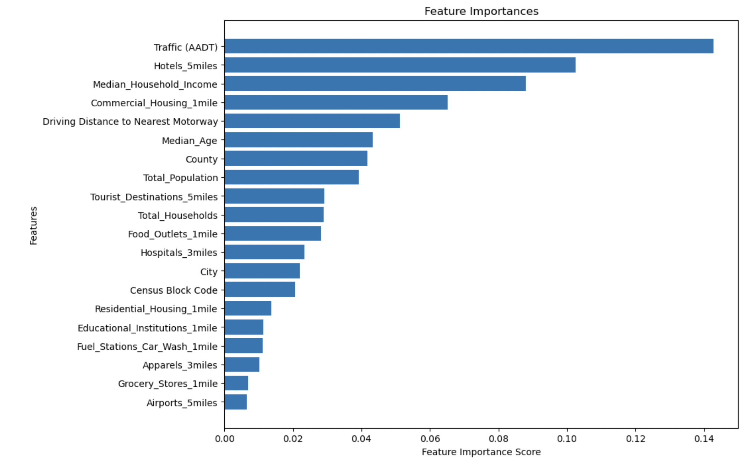
06
21
Model Building
Stage 1 | Predictive Model Building
Notes:
HJ

Slide 22




06
22
Model Building
Stage 2 | Heuristic Scoring Model
Traffic
Proximity
Essential Amenities
Non-Essential Amenities
Demographics
25%
25%
20%
10%
20%
Normalized traffic volume and distances to highways to a 0-5 scale, highlighting the importance of easy access.
Essential and non-essential amenities are evaluated separately, with scores adjusted to reflect their relative importance.
Population dynamics within a specific age and gender demographic are scored for potential market size.
The final location suitability score is a weighted sum of all components, balanced according to predetermined weights.

Slide 23
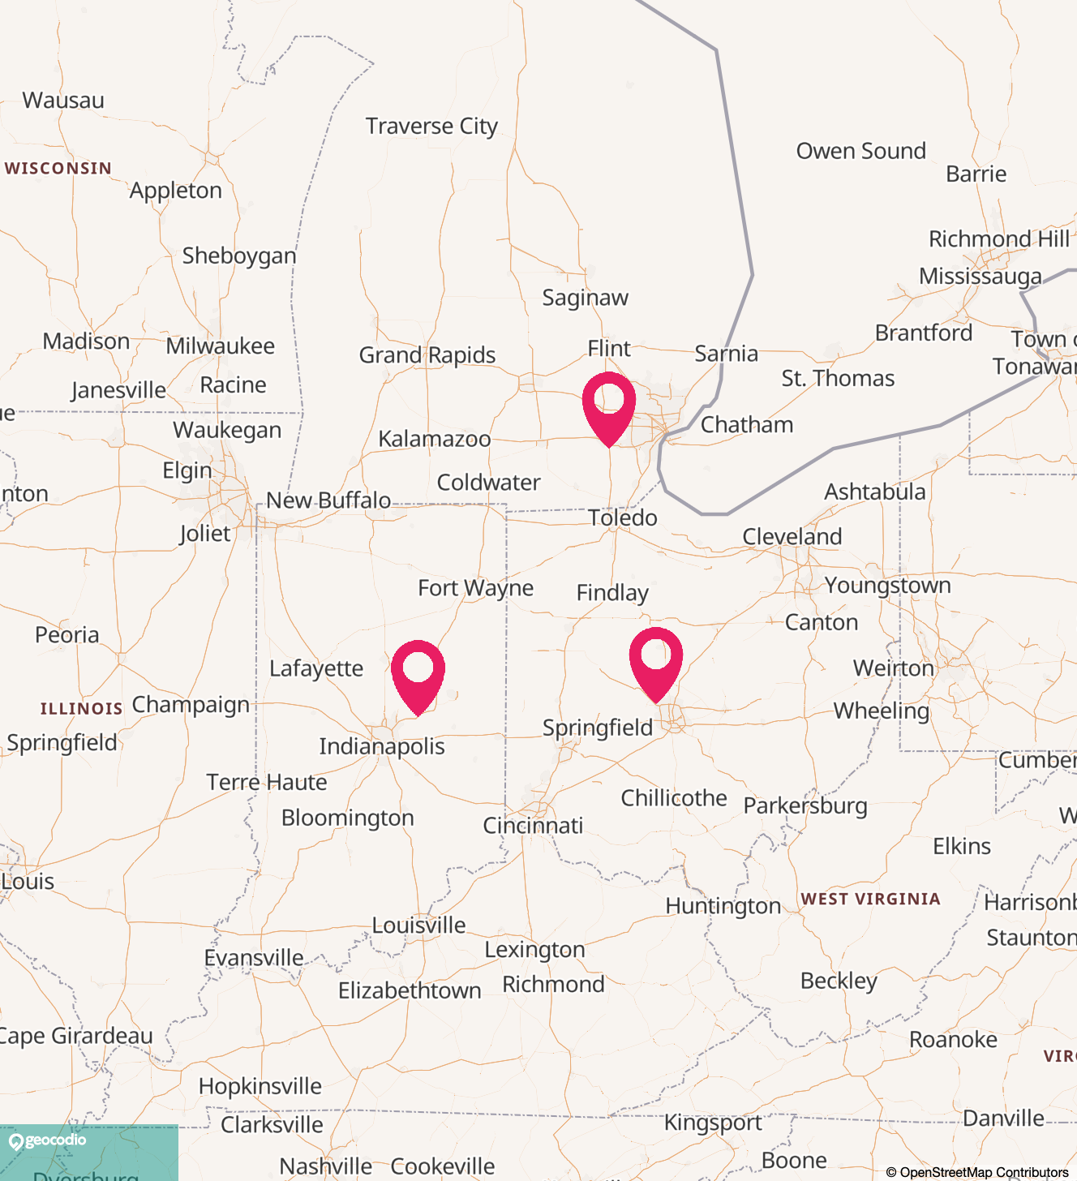
06
23
Model Building
Stage 3 | Predicting Shortlisted Site Visits
Michigan
Predicted Visits: 32929
Heuristic Score: 3.752
Traffic (AADT): 9308
Ohio
Predicted Visits: 32816
Heuristic Score: 3.487
Traffic (AADT): 2390
Indiana
Predicted Visits: 30717
Heuristic Score: 3.104
Traffic (AADT): 2077
Notes:
32929.792969

Slide 24









07
24
Deployment and Life Cycle
Data Integration & Storage
Building data frameworks in spreadsheets or SQL for Meijer and Competitor stores
Data Sourcing
Modeling & Processing
Web Scraping to update existing store data & collect new store location data
Updating the predictive model for gauging no. of visits and the heuristic scoring model to understand location performance
Visualization & Reporting
Interactive Dashboard to assess the performance of stores belonging to Meijer and its Competitors
Notes:
HJ

Slide 25
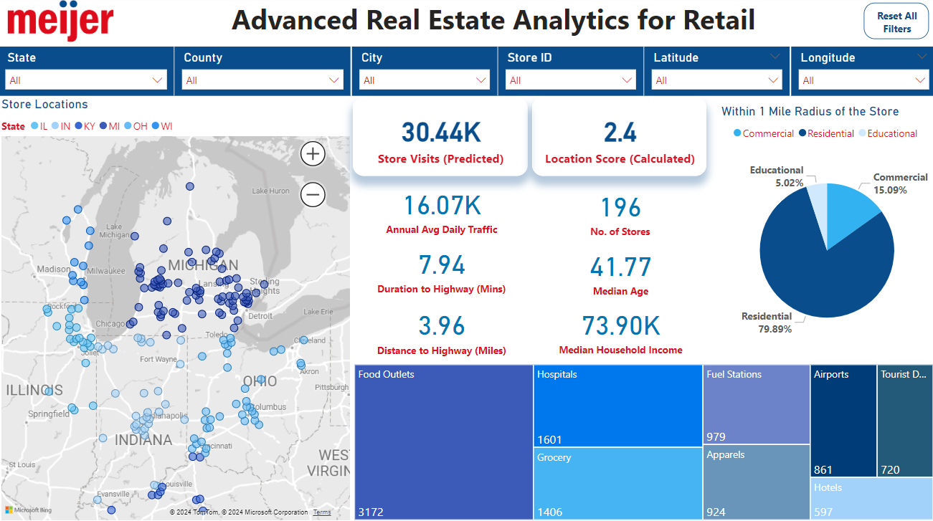

Slide 26



08
26
Limitations and Future Scope
Address current limitations and expand the model's capabilities for broader, future applications
01
Web-Scraping Geospatial Data
Traffic AADT data could also be obtained for the remaining states in the US, although not all states offer a direct download option.
It is crucial to verify the accuracy of data obtained from free APIs, such as Overpass, to ensure reliability.
02
Customer Data
The inclusion of features related to customer sentiments, such as Google and Yelp reviews, was considered but not implemented due to the exhaustion of free API trial search calls, preventing the scraping of reviews for all Meijer stores.
03
Model Performance & Accuracy
Enhancing the model's accuracy is achievable by expanding the dataset to include more no. of stores from competitors, effectively increasing the size of the training dataset and subsequently of the R-Squared metric to explain variability.
Notes:
HJ

Slide 27
Thank You

